Slide 1
Module – 2 Smart Objects: The “Things” in IoT
Smart Objects: The “Things” in IoT:
Sensors, Actuators, and Smart Objects:
This sections describe the capabilities, characteristics, and functionality of sensors and actuators.
It gives detail how the economic and technical conditions are finally right for IoT to flourish.

Slide 2
Module – 2 Smart Objects: The “Things” in IoT
Sensors:
A sensor senses. More specifically, a sensor measures some physical quantity and converts that measurement reading into a digital representation.
That digital representation is typically passed to another device for transformation into useful data that can be consumed by intelligent devices or humans.
Sensors provide superhuman sensory capabilities
Sensors can be readily embedded in any physical objects that are easily
connected to the Internet by wir^{Dr}e^{. S}d^{yed} o^{Mu}r^{sta}w^{fa,} i^{H}r^{K}e^{BK}l^{C}e^{E} ss networks
11

Slide 3
Module – 2 Smart Objects: The “Things” in IoT
Sensors:
There are a number of ways to group and cluster sensors into different categories, they are:
1. Active or passive
3. Contact or no-contact
5. Area of application
7. What sensors measure:
2. Invasive or non-invasive
4. Absolute or relative
6. How sensors measure

Slide 4
Module – 2 Smart Objects: The “Things” in IoT
Sensors:
Active or passive:
Sensors can be categorized based on whether they produce an energy output and typically require an external power supply (active) or whether they simply receive energy and typically require no external power supply (passive).
Invasive or non-invasive:
Sensors can be categorized based on whether a sensor is part of the environment it is measuring (invasive) or external to it (non-invasive).

Slide 5
Module – 2 Smart Objects: The “Things” in IoT
Sensors:
Contact or no-contact:
Sensors can be categorized based on whether they require physical contact with what they are measuring (contact) or not (no-contact).
Absolute or relative:
Sensors can be categorized based on whether they measure on an absolute scale (absolute) or based on a difference with a fixed or variable reference value (relative).

Slide 6
Module – 2 Smart Objects: The “Things” in IoT
Sensors:
Area of application:
Sensors can be categorized based on the specific industry or vertical where they are being used.
How sensors measure:
Sensors can be categorized based on the physical mechanism used to measure sensory input (for example, thermoelectric, electrochemical, piezoresistive, optic, electric, fluid mechanic, photoelastic).
What sensors measure:
Sensors can be categorized based on their applications or what physical variables they measure.

Slide 7
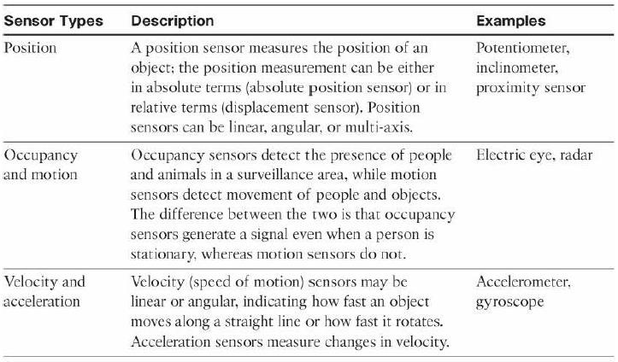
Module – 2 Smart Objects: The “Things” in IoT
Sensors: Categorization based on what physical phenomenon a sensor is measuring:

Slide 8
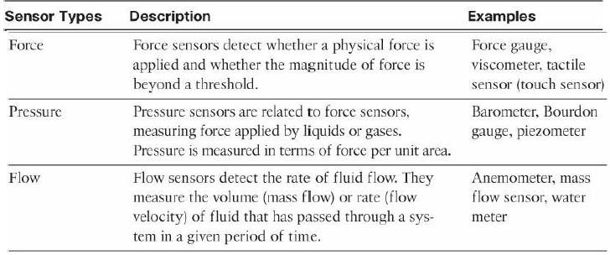
Module – 2 Smart Objects: The “Things” in IoT
Sensors: Categorization based on what physical phenomenon a sensor is measuring:

Slide 9
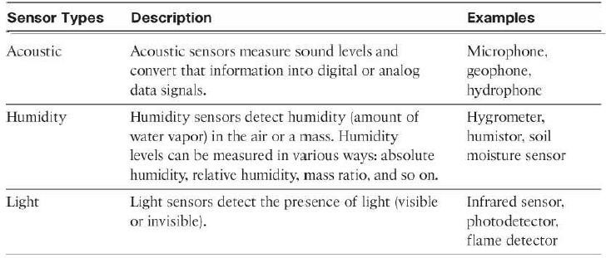
Module – 2 Smart Objects: The “Things” in IoT
Sensors: Categorization based on what physical phenomenon a sensor is measuring:

Slide 10
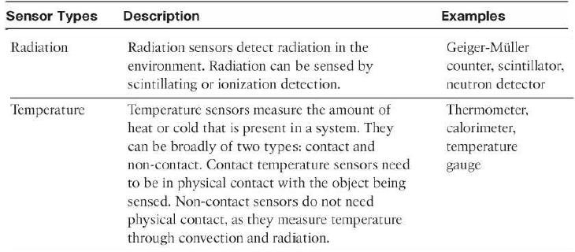
Module – 2 Smart Objects: The “Things” in IoT
Sensors: Categorization based on what physical phenomenon a sensor is measuring:

Slide 11
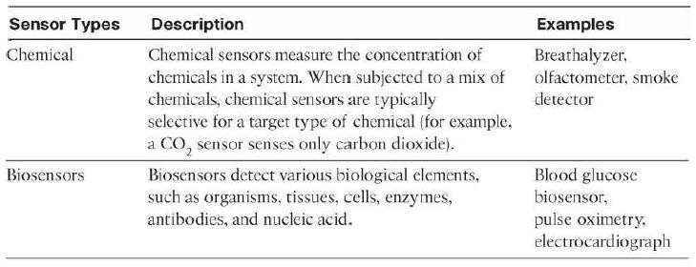
Module – 2 Smart Objects: The “Things” in IoT
Sensors: Categorization based on what physical phenomenon a sensor is measuring:

Slide 12
Module – 2 Smart Objects: The “Things” in IoT
Sensors:
Sensors come in all shapes and sizes and can measure all types of physical conditions.
A fascinating use case to highlight the power of sensors and IoT is in the area of precision agriculture (sometimes referred to as smart farming), which uses a variety of technical advances to improve the efficiency, sustainability, and profitability of traditional farming practices.
This includes the use of GPS and satellite aerial imagery for determining field viability; robots for high-precision planting, harvesting, irrigation, and so on; and real-time analytics and artificial intelligence to predict optimal crop yield, weather impacts, and soil quality.

Slide 13
Module – 2 Smart Objects: The “Things” in IoT
Sensors:
The most significant impacts of precision agriculture are those dealing with sensor measurement of a variety of soil characteristics.
These include real-time measurement of soil quality, pH levels, salinity, toxicity levels,
moisture levels for irrigation planning, nutrient levels for fertilization planning.
All this detailed sensor data can be analyzed to provide highly valuable and actionable insight to boost productivity and crop yield.
Figure shows biodegradable, passive microsensors to measure soil and crop and conditions.
These sensors, developed at North Dakota State University (NDSU), can be planted directly in the soil and left in the ground to biodegrade without any harm to soil quality.

Slide 14
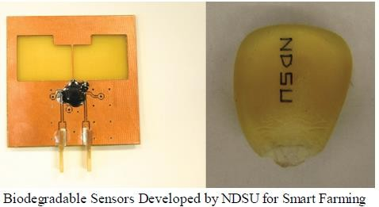
Module – 2 Smart Objects: The “Things” in IoT
Sensors:

Slide 15
Module – 2 Smart Objects: The “Things” in IoT
Sensors:
IoT and by extension, networked sensors have been repeatedly named among a small number of emerging revolutionary technologies that will change the global economy and shape the future.
The astounding volume of sensors is in large part due to their smaller size, their form factor,
and their decreasing cost.
These factors make possible the economic and technical feasibility of having an increased density of sensors in objects of all types.
most significant accelerator for sensor deployments is mobile phones.
More than a billion smart phones are sold each year, and each one has well over a dozen sensors inside it

Slide 16
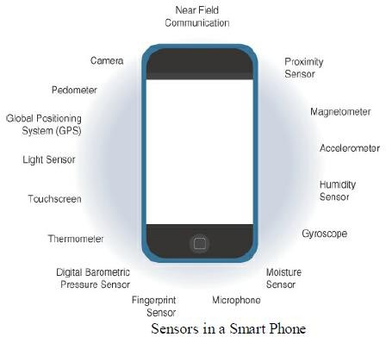
Module – 2 Smart Objects: The “Things” in IoT
Sensor
s:

Slide 17
Module – 2 Smart Objects: The “Things” in IoT
Sensors:
There are smart homes with potentially hundreds of sensors, intelligent vehicles with 100+ sensors each, connected cities with thousands upon thousands of connected sensors, and the list goes on and on.
Figure shows the explosive year-over-year increase over the past several years and some bold
predictions for sensor numbers in the upcoming years.
The sensor industry that this number will eclipse a trillion in the next few years.
In fact, many large players in the sensor industry have come together to form industry consortia, such as the TSensors Summits (www.tsensorssummit.org), to create a strategy and roadmap for a trillion sensor economy.
The trillion-sensor economy will be of such an unprecedented and unimaginable scale that it
will change the world forever.
This is the power of IoT.
Dr. Syed Mustafa, HKBKCE 26

Slide 18
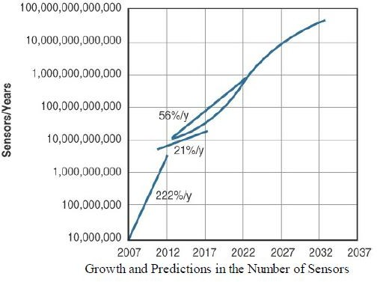
Module – 2 Smart Objects: The “Things” in IoT
Sensors:

Slide 19
Module – 2 Smart Objects: The “Things” in IoT
Actuators:
Actuators are natural complements to sensors.
Figure demonstrates the symmetry and complementary nature of these two types of devices.
sensors are designed to sense and measure practically any measurable variable in the
physical world.
They convert their measurements (typically analog) into electric signals or digital
representations that can be consumed by an intelligent agent (a device or a human).
Actuators, receive some type of control signal (commonly an electric signal or digital command) that triggers a physical effect, usually some type of motion, force, and so on.

Slide 20
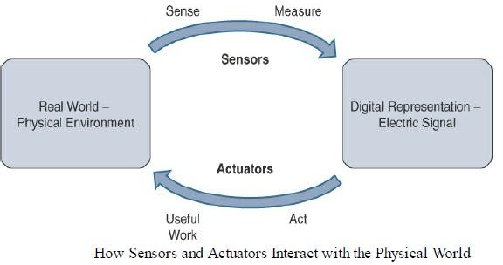
Module – 2 Smart Objects: The “Things” in IoT
Actuators:

Slide 21
Module – 2 Smart Objects: The “Things” in IoT
Actuators:
IoT sensors are devices that sense and measure the physical world and (typically) signal their measurements as electric signals sent to some type of microprocessor or microcontroller for additional processing.
Correspondingly, a processor can send an electric signal to an actuator that translates the signal into some type of movement (linear, rotational, and so on) or useful work that changes or has a measurable impact on the physical world.
This interaction between sensors, actuators, and processors and the similar functionality in biological systems is the basis for various technical fields, including robotics and biometrics.

Slide 22
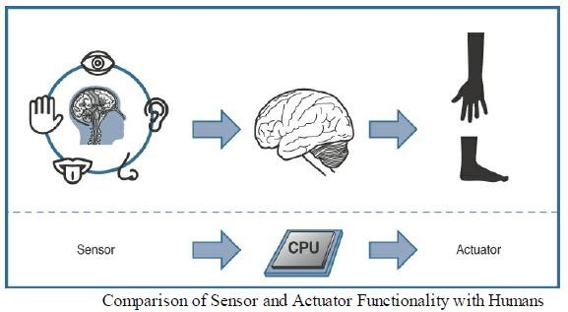
Module – 2 Smart Objects: The “Things” in IoT
Actuators:

Slide 23
Module – 2 Smart Objects: The “Things” in IoT
Actuators:
Actuators vary greatly in function, size, design, and so on.
Some common ways that they can be classified include the following:
Type of motion
Power
Binary or continuous
Area of application
Type of energy

Slide 24
Module – 2 Smart Objects: The “Things” in IoT
Actuators:
Type of motion:
Actuators can be classified based on the type of motion they produce (for example, linear, rotary, one/two/three-axes).
Power:
Actuators can be classified based on their power output (for example, high power, low power, micro power)
Binary or continuous:
Actuators can be classified based on the number of stable-state outputs.
Area of application:
Actuators can be classified based on the specific industry or vertical where they are used.
Type of energy:
Actuators can be classified based on their energy type

Slide 25
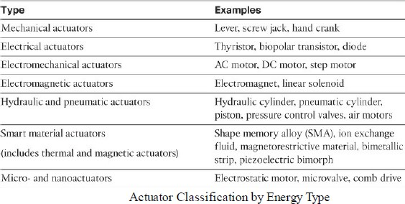
Module – 2 Smart Objects: The “Things” in IoT
Actuators:
The most commonly used classification is based on energy type.
Table shows actuators classified by energy type and some examples for each type

Slide 26
Module – 2 Smart Objects: The “Things” in IoT
Actuators:
Sensors provide the information, actuators provide the action.
The most interesting use cases for IoT are those where sensors and actuators work together in an intelligent.
For example, the smart sensors used to evaluate soil quality (by measuring a variety of soil, temperature, and plant characteristics) can be connected with electrically or pneumatically controlled valve actuators that control water, pesticides, fertilizers, herbicides, and so on.
Intelligently triggering a high-precision actuator based on well-defined sensor readings of temperature, pH, soil/air humidity, nutrient levels, and so on to deliver a highly optimized and custom environment-specific solution is truly smart farming.

Slide 27
Module – 2 Smart Objects: The “Things” in IoT
Micro-Electro-Mechanical Systems (MEMS):
One of the most interesting advances in sensor and actuator technologies is in how they are packaged and deployed.
Micro-electro-mechanical systems (MEMS), sometimes simply referred to as micro-machines, can integrate and combine electric and mechanical elements, such as sensors and actuators, on a very small (millimeter or less) scale.
One of the keys to this technology is a microfabrication technique that is similar to what is
used for microelectronic integrated circuits.
This approach allows mass production at very low costs.

Slide 28
Module – 2 Smart Objects: The “Things” in IoT
Micro-Electro-Mechanical Systems (MEMS):
The combination of tiny size, low cost, and the ability to mass produce makes MEMS an attractive option for a huge number of IoT applications.
MEMS devices have already been widely used in a variety of different applications and can be
found in very familiar everyday devices.
For example, inkjet printers use micro pump MEMS.
Smart phones also use MEMS technologies for things like accelerometers and gyroscopes.
Automobiles were among the first to commercially introduce MEMS into the mass market, with airbag accelerometers.

Slide 29
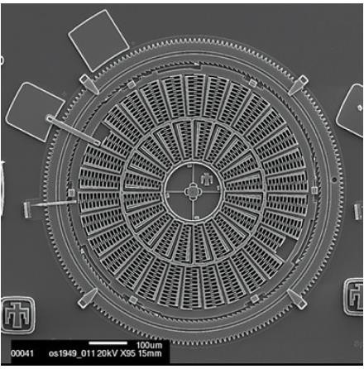
Module – 2 Smart Objects: The “Things” in IoT
Micro-Electro-Mechanical Systems (MEMS):
Torsional ratcheting actuator (TRA) MEMS that was developed by Sandia National Laboratory as a low- voltage alternative to a micro-engine.
This MEMS is only a few hundred micrometers across; a scanning electron microscope is needed to show the level of detail visible in the figure.
Micro-scale sensors and actuators are immensely embeddable in everyday objects, which is a defining characteristic of IoT.
38

Slide 30
Module – 2 Smart Objects: The “Things” in IoT
Smart Objects:
Smart objects are the building blocks of IoT.
They transform everyday objects into a network of intelligent objects that are able to learn from and interact with their environment in a meaningful way.
If soil sensor is connected as part of an intelligent network that is able to coordinate intelligently with actuators to trigger irrigation systems as needed based on those sensor readings, we have something far more powerful.
The coordinated sensor/actuator set is intelligently interconnected with other sensor/actuator sets to further coordinate fertilization, pest control, and so on—and even communicate with an intelligent backend to calculate crop yield potential.

Slide 31
Module – 2 Smart Objects: The “Things” in IoT
Smart Objects:
The term smart object is often used interchangeably with terms such as smart sensor, smart device, IoT device, intelligent device, thing, smart thing, intelligent node, intelligent thing, ubiquitous thing, and intelligent product.
Definition:
A smart object is a device that has, at a minimum, the following four defining characteristics:
1. Processing unit
3. Communication device
2. Sensor(s) and/or actuator(s)
4. Power source

Slide 32
Module – 2 Smart Objects: The “Things” in IoT
Smart Objects:
1. Processing unit:
A smart object has some type of processing unit for acquiring data, processing and analyzing sensing information received by the sensor(s), coordinating control signals to any actuators, and controlling a variety of functions on the smart object, including the communication and power systems.
➢
The most common is a microcontroller because of its small form factor, flexibility,
programming simplicity, ubiquity, low power consumption, and low cost

Slide 33
Module – 2 Smart Objects: The “Things” in IoT
Smart Objects:
Sensor(s) and/or actuator(s):
A smart object is capable of interacting with the physical world through sensors and actuators.
A sensor learns and measures its environment, whereas an actuator is able to produce some
change in the physical world.
A smart object does not need to contain both sensors and actuators.
In fact, a smart object can contain one or multiple sensors and/or actuators, depending upon the application.

Slide 34
Module – 2 Smart Objects: The “Things” in IoT
Smart Objects:
Communication device:
The communication unit is responsible for connecting a smart object with other smart objects and the outside world (via the network).
Communication devices for smart objects can be either wired or wireless.
In IoT networks smart objects are wirelessly interconnected for a number of reasons, including cost, limited infrastructure availability, and ease of deployment.
There are myriad different communication protocols for smart objects.

Slide 35
Module – 2 Smart Objects: The “Things” in IoT
Smart Objects:
Power source:
Smart objects have components that need to be powered.
Most significant power consumption comes from the communication unit of a smart object.
The power requirements vary greatly from application to application.
Smart objects are limited in power, are deployed for a very long time, and are not easily
accessible.
This combination, when the smart object relies on battery power, implies that power efficiency, judicious power management, sleep modes, ultra-low power consumption
hardware, and so on are critical design^{D}e^{r. S}l^{y}e^{e}m^{d M}e^{us}n^{ta}t^{fa}s^{, HKBKCE}
44

Slide 36
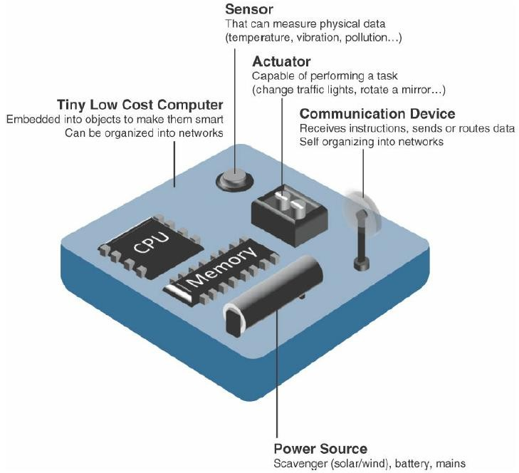
Module – 2 Smart Objects: The “Things” in IoT
Smart Objects:
Characteristics of a Smart Ob_{D}je_{r.} c_{Sy}t_{ed Mustafa, HKBKCE}
45

Slide 37
Module – 2 Smart Objects: The “Things” in IoT
Trends in Smart Objects:
Broad generalizations and trends impacting IoT:
Size is decreasing
Power consumption is decreasing
Processing power is increasing
Communication capabilities are improving
Communication is being increasingly standardized
Dr. Syed Mustafa, HKBKCE
46

Slide 38
Module – 2 Smart Objects: The “Things” in IoT
Trends in Smart Objects:
Broad generalizations and trends impacting IoT:
Size is decreasing:
In reference to MEMS, there is a clear trend of ever-decreasing size.
Some smart objects are so small they are not even visible to the naked eye.
This reduced size makes smart objects easier to embed in everyday objects.
Power consumption is decreasing:
The different hardware components of a smart object continually consume less power.
This is especially truef or sensors, many of which are completely passive.
Some battery powered sensors last 1^{D}0^{r. S}o^{ye}r^{d} m^{Mu}o^{st}rªe^{fa,} y^{H}e^{KB}a^{K}r^{C}s^{E} without battery replacement.
47

Slide 39
Module – 2 Smart Objects: The “Things” in IoT
Trends in Smart Objects:
Broad generalizations and trends impacting IoT:
Processing power is increasing:
Processors are continually getting more powerful and smaller.
This is a key advancement for smart objects, as they become increasingly complex and connected.
Communication capabilities are improving:
wireless speeds are continually increasing, but they are also increasing in range.
IoT is driving the development of more and more specialized communication protocols covering a greater diversity of use cases and environments.

Slide 40
Module – 2 Smart Objects: The “Things” in IoT
Trends in Smart Objects:
Broad generalizations and trends impacting IoT:
Communication is being increasingly standardized:
There is a strong push in the industry to develop open standards for IoT communication
protocols.
In addition, there are more and more open source efforts to advance IoT.

Slide 41
Module – 2 Smart Objects: The “Things” in IoT
Sensor Networks:
A sensor/actuator network (SANET), is a network of sensors that sense and measure their environment and/or actuators that act on their environment.
The sensors and/or actuators in a SANET are capable of communicating and cooperating in a productive manner.
Effective and well coordinated communication and cooperation is a prominent challenge, primarily because the sensors and actuators in SANETs are diverse, heterogeneous, and resource-constrained.

Slide 42
Module – 2 Smart Objects: The “Things” in IoT
Sensor Networks:
SANETs offer highly coordinated sensing and actuation capabilities.
Smart homes are a type of SANET that display this coordination between distributed sensors and actuators.
For example, smart homes can have temperature sensors that are strategically networked with heating, ventilation, and air-conditioning (HVAC) actuators.
When a sensor detects a specified temperature, this can trigger an actuator to take action and heat or cool the home as needed.

Slide 43
Module – 2 Smart Objects: The “Things” in IoT
Sensor Networks:
The following are some advantages and disadvantages that a wireless-based solution offers: Advantages:
Greater deployment flexibility (especially in extreme environments or hard-to-reach places)
Simpler scaling to a large number of nodes
Lower implementation costs
Easier long-term maintenance
Effortless introduction of new sensor/actuator nodes
Better equipped to handle dynamic/ra_{D}p_{r.} i_{S}d_{yed}t_{M}o_{u}p_{sta}o_{fa}l,o_{HK}g_{B}y_{KCE}changes
52

Slide 44
Module – 2 Smart Objects: The “Things” in IoT
Sensor Networks:
Disadvantages:
Potentially less secure (for example, hijacked access points)
Typically lower transmission speeds
Greater level of impact/influence by environment

Slide 45
Module – 2 Smart Objects: The “Things” in IoT
Wireless Sensor Networks (WSNs):
Wireless sensor networks are made up of wirelessly connected smart objects, which are referred to as motes.
The following are some of the most significant limitations of the smart objects in WSNs:
Limited processing power
Limited memory
Lossy communication
Limited transmission speeds
Limited power

Slide 46
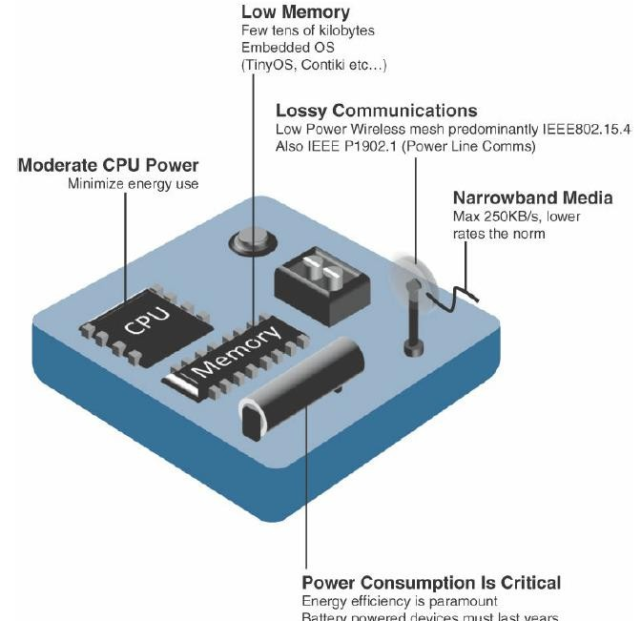
Module – 2 Smart Objects: The “Things” in IoT
Sensor Networks:
Design Constraints for Wireless Smart Ob_{D}j_{r}e_{. S}c_{y}t_{e}s_{d Mustafa, HKBKCE}
55

Slide 47
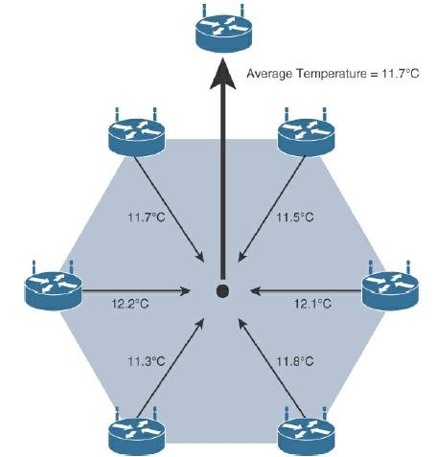
Module – 2 Smart Objects: The “Things” in IoT
Sensor Networks:
Data Aggregation in Wireless Sensor Networks Smart Objects

Slide 48
Module – 2 Smart Objects: The “Things” in IoT
Sensor Networks:
The data aggregation techniques are helpful in reducing the amount of overall traffic (and energy) in WSNs with very large numbers of deployed smart objects.
This data aggregation at the network edges is where fog and mist computing are critical IoT architectural elements needed to deliver the scale and performance required by so many IoT use cases.

Slide 49
Module – 2 Smart Objects: The “Things” in IoT
Sensor Networks:
Wirelessly connected smart objects generally have one of the following two communication patterns:
Event-driven:
Transmission of sensory information is triggered only when a smart object detects a
particular event or predetermined threshold.
Periodic:
Transmission of sensory information occurs only at periodic intervals.

Slide 50
Module – 2 Connecting Smart Objects
Connecting Smart Objects:
“Communications Criteria,” describes the characteristics and attributes should be considered when selecting and dealing with connecting smart objects.
The various technologies used for connecting sensors can differ greatly depending on the criteria used to analyze them.
1. Range 2. Frequency Bands
3. Power Consumption 4. Topology
5. Constrained Devices 6. Constrained-Node Networks

Slide 51
Module – 2 Connecting Smart Objects
Communications Criteria:
1. Range:
How far does the signal need to be propagated?
what will be the area of coverage for a selected wireless technology? Should indoor versus outdoor deployments be differentiated?
i. Short range:
The classical wired example is a serial cable.

Slide 52
Module – 2 Connecting Smart Objects
Communications Criteria:
1. Range:
i. Short range:
Wireless short-range technologies are often considered as an alternative to a serial cable, supporting tens of meters of maximum distance between two devices.
Examples of short-range wireless technologies are IEEE 802.15.1 Bluetooth and IEEE 802.15.7
Visible Light Communications(VLC).

Slide 53
Module – 2 Connecting Smart Objects
Communications Criteria:
ii. Medium range:
This range is the main category of IoT access technologies.
In the range of tens to hundreds of meters, many specifications and implementations are available.
The maximum distance is generally less than 1 mile between two devices, although RF technologies do not have real maximum distances defined, as long as the radio signal is transmitted and received in the scope of the applicable specification.

Slide 54
Module – 2 Connecting Smart Objects
Communications Criteria:
ii. Medium range:
Examples of medium-range wireless technologies include IEEE 802.11 Wi-Fi, IEEE 802.15.4, and 802.15.4g WPAN.
Wired technologies such as IEEE 802.3 Ethernet and IEEE 1901.2 Narrowband Power Line Communications (PLC) may also be classified as medium range, depending on their physical media characteristics.

Slide 55
Module – 2 Connecting Smart Objects
Communications Criteria:
iii. Long range:
Distances greater than 1 mile between two devices require long-range technologies.
Wireless examples are cellular (2G, 3G, 4G) and some applications of outdoor IEEE 802.11 Wi-Fi and Low-Power Wide-Area (LPWA) technologies.
LPWA communications have the ability to communicate over a large area without consuming
much power.
These technologies are therefore ideal for battery-powered IoT sensors.
IEEE 802.3 over optical fiber and IEEE 1901 Broadband Power Line Communications are
classified as long range
64

Slide 56
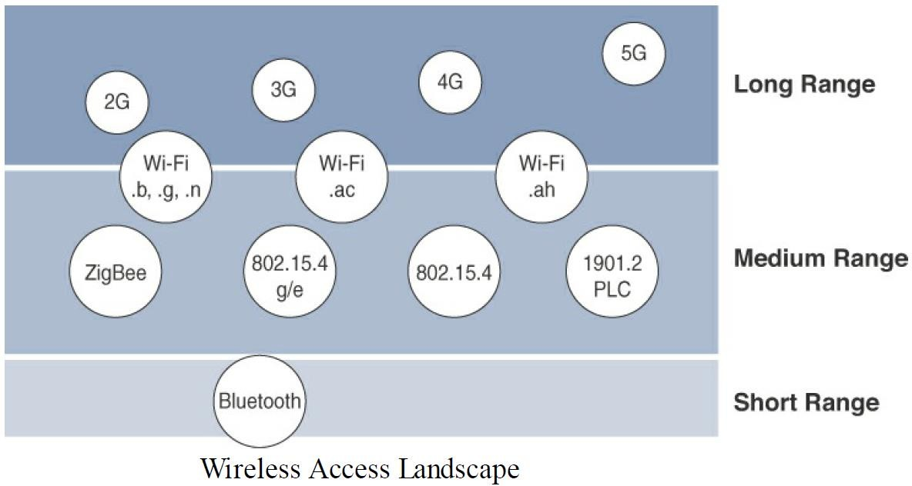
Module – 2 Connecting Smart Objects
Communications
Criteria:

Slide 57
Module – 2 Connecting Smart Objects
Frequency Bands:
On IoT access technologies, the frequency bands leveraged by wireless communications are split between licensed and unlicensed bands.
Licensed spectrum is generally applicable to IoT long-range access technologies and allocated to communications infrastructures deployed by services providers, public services (for example, first responders, military), broadcasters, and utilities.
Examples of licensed spectrum commonly used for IoT access are cellular, WiMAX, and Narrowband IoT (NB-IoT) technologies.

Slide 58
Module – 2 Connecting Smart Objects
Frequency Bands:
Radio spectrum is regulated by countries and/or organizations, such as the International Telecommunication Union (ITU) and the Federal Communications Commission (FCC).
These groups define the regulations and transmission requirements for various frequency bands.
For example, portions of the spectrum are allocated to types of telecommunications such as radio, television, military, and so on.

Slide 59
Module – 2 Connecting Smart Objects
Frequency Bands:
The ITU has also defined unlicensed spectrum for the industrial, scientific, and medical (ISM) portions of the radio bands for short-range devices (SRDs).
Unlicensed means that no guarantees or protections are offered in the ISM bands for device communications.
For IoT access, these are the most well-known ISM bands:
2.4 GHz band as used by IEEE 802.11b/g/n Wi-Fi
IEEE 802.15.1 Bluetooth
IEEE 802.15.4 WPAN(Wireless Personal Area Network).

Slide 60
Module – 2 Connecting Smart Objects
Frequency Bands:
The frequency of transmission directly impacts how a signal propagates and its practical maximum range.
Some communications within the ISM bands operate in the sub-GHz range.
Sub-GHz bands are used by protocols such as IEEE 802.15.4, 802.15.4g, and 802.11ah, and LPWA technologies such as LoRa and Sigfox.
Either for indoor or outdoor deployments, the sub-GHz frequency bands allow greater distances between devices.
➢ These bands have a better ability than the 2.4 GHz ISM band to penetrate building infrastructures or go
around obstacles, while keeping the transmit power within regulation.

Slide 61
Module – 2 Connecting Smart Objects
Frequency Bands:
The frequency of transmission directly impacts how a signal propagates and its practical maximum range.
Some communications within the ISM bands operate in the sub-GHz range.
Sub-GHz bands are used by protocols such as IEEE 802.15.4, 802.15.4g, and 802.11ah, and LPWA(Low-Power Wide-Area) technologies such as LoRa and Sigfox.
Either for indoor or outdoor deployments, the sub-GHz frequency bands allow greater distances between devices.
➢ These bands have a better ability than the 2.4 GHz ISM band to penetrate building infrastructures or go
around obstacles, while keeping the transmit power within regulation.

Slide 62
Module – 2 Connecting Smart Objects
Frequency Bands:
The disadvantage of sub-GHz frequency bands is their lower rate of data delivery compared to higher frequencies.
Most IoT sensors do not need to send data at high rates.
Therefore, the lower transmission speeds of sub-GHz technologies are usually not a concern for IoT sensor deployments.
For example, in most European countries, the 169 MHz band is often considered best suited for wireless water and gas metering applications.
This is due to its good deep building basement signal penetration, the low data rate of this frequency
matches the low volume of data that needs to be transmitted.

Slide 63
Module – 2 Connecting Smart Objects
Frequency Bands:
Several sub-GHz ranges have been defined in the ISM band.
The most wellknown ranges are centered on 169 MHz, 433 MHz, 868 MHz, and 915 MHz.
most IoT access technologies tend to focus on the two sub-GHz frequency regions around 868 MHz and 915 MHz.
These main bands are commonly found throughout the world and are applicable to nearly all
countries.

Slide 64
Module – 2 Connecting Smart Objects
Frequency Bands:
The European Conference of Postal and Telecommunications Administrations (CEPT), in the European Radio communications Committee (ERC)Recommendation 70-03, defines the 868 MHz frequency band.
CEPT was established in 1959 as a coordinating body for European state telecommunications and postal organizations.
India, the Middle East, Africa, and Russia have adopted the CEPT definitions.
Recommendation 70-03 mostly characterizes the use of the 863–870 MHz band, the allowed transmit power, or EIRP (effective isotropic radiated power), and duty cycle (that is, the percentage of time a device can be active in transmission).

Slide 65
Module – 2 Connecting Smart Objects
Frequency Bands:
EIRP is the amount of power that an antenna would emit to produce the peak power density observed in the direction of maximum antenna gain.
The 868 MHz band is applicable to IoT access technologies such as IEEE 802.15.4 and 802.15.4g, 802.11ah, and LoRaWAN.
Smart objects running over unlicensed bands can be easily optimized in terms of hardware supporting the two main worldwide sub-GHz frequencies, 868 MHz and 915 MHz.
However, parameters such as transmit power, antennas, and EIRP must be properly designed to follow the settings required by each country’s regulations.

Slide 66
Module – 2 Connecting Smart Objects
Power Consumption:
powered nodes and battery-powered nodes.
A powered node has a direct connection to a power source, and communications are usually not limited
by power consumption criteria.
Ease of deployment of powered nodes is limited by the availability of a power source, which makes mobility more complex.
Battery-powered nodes bring much more flexibility to IoT devices.
These nodes are often classified by the required lifetimes of their batteries.

Slide 67
Module – 2 Connecting Smart Objects
Power Consumption:
For devices under regular maintenance, a battery life of 2 to 3 years is an option.
IoT wireless access technologies must address the needs of low power consumption and connectivity for battery-powered nodes.
This has led to the evolution of a new wireless environment known as Low-Power Wide-Area (LPWA)
It is possible to run just about any wireless technology on batteries.
However, in reality, no operational deployment will be acceptable if hundreds of batteries must be
changed every month

Slide 68
Module – 2 Connecting Smart Objects
Topology:
Among the access technologies available for connecting IoT devices, three main topology schemes are dominant: star, mesh, and peer-to-peer.
For long range and short-range technologies, a star topology is prevalent, as seen with cellular, LPWA, and Bluetooth networks.
Star topologies utilize a single central base station or controller to allow communications with endpoints.

Slide 69
Module – 2 Connecting Smart Objects
Topology:
For medium-range technologies, a star, peer-to-peer, or mesh topology is common.
Peer-to-peer topologies allow any device to communicate with any other device as long as they are in range of each other.
Obviously, peer-to-peer topologies rely on multiple full-function devices.
Peer-to-peer topologies enable more complex formations, such as a mesh networking
topology.

Slide 70
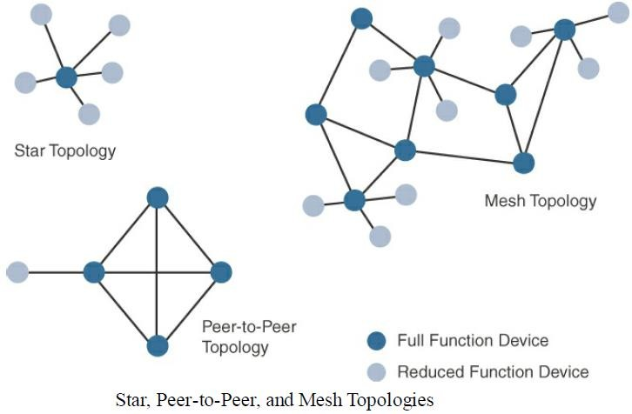
Module – 2 Connecting Smart Objects
4. Topology:

Slide 71
Module – 2 Connecting Smart Objects
4. Topology:
For example,
indoor Wi-Fi deployments are mostly a set of nodes forming a star topology around their access points (APs).
Meanwhile,
outdoor Wi-Fi may consist of a mesh topology for the backbone of APs, with nodes connecting
to the APs in a star topology.
Similarly, IEEE 802.15.4 and 802.15.4g and even wired IEEE 1901.2a PLC are generally deployed
as a mesh topology.

Slide 72
Module – 2 Connecting Smart Objects
Topology:
A mesh topology helps cope with low transmit power, searching to reach a greater overall distance, and coverage by having intermediate nodes relaying traffic for other nodes.
Mesh topology requires the implementation of a Layer 2 forwarding protocol known as mesh-under or a Layer 3 forwarding protocol referred to as mesh over on each intermediate node.
An intermediate node or full-function device (FFD) is simply a node that interconnects other nodes.
A node that doesn’t interconnect or relay the traffic of other nodes is known as a leaf node,
or reduced-function device (RFD).

Slide 73
Module – 2 Connecting Smart Objects
Constrained Devices:
The Internet Engineering Task Force (IETF) acknowledges in RFC 7228 that different categories of IoT devices are deployed.
While categorizing the class of IoT nodes is a perilous exercise, with computing, memory, storage, power, and networking continuously evolving and improving, RFC 7228 gives some definitions of constrained nodes.
These definitions help differentiate constrained nodes from unconstrained nodes, such as servers, desktop or laptop computers, and powerful mobile devices such as smart phones.
Constrained nodes have limited resources that impact their networking feature set and
capabilities.

Slide 74
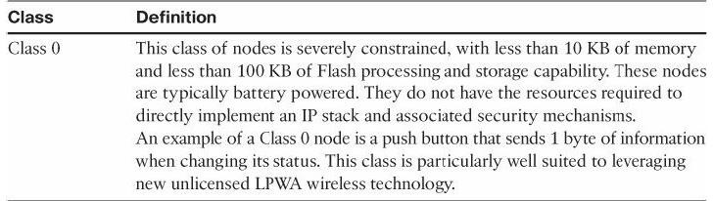
Module – 2 Connecting Smart Objects
Constrained Devices:
some classes of IoT nodes do not implement an IP stack.
According to RFC 7228, constrained nodes can be broken down into the classes

Slide 75
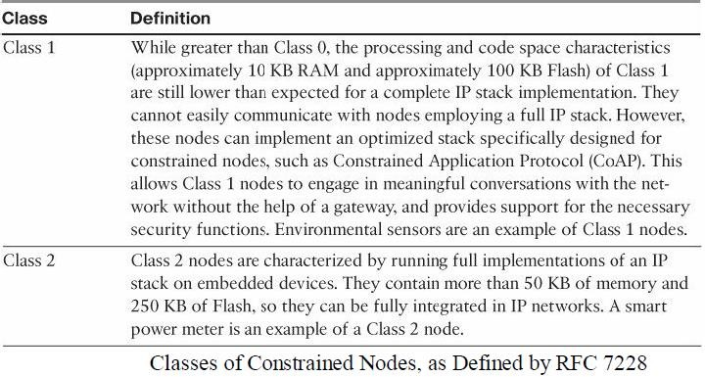
Module – 2 Connecting Smart Objects
5. Constrained Devices:

Slide 76
Module – 2 Connecting Smart Objects
Constrained-Node Networks:
While several of the IoT access technologies, such as Wi-Fi and cellular, are applicable to laptops, smart phones, and some IoT devices, some IoT access technologies are more suited to specifically connect constrained nodes.
Typical examples are IEEE 802.15.4 and 802.15.4g RF, IEEE 1901.2a PLC, LPWA, and IEEE 802.11ah access technologies.
Constrained-node networks are often referred to as low-power and lossy networks (LLNs).
Low-power in the context of LLNs refers to the fact that nodes must cope with the
requirements from powered and battery-powered constrained nodes.

Slide 77
Module – 2 Connecting Smart Objects
Constrained-Node Networks:
Lossy networks indicates that network performance may suffer from interference and variability due to harsh radio environments.
Layer 1 and Layer 2 protocols that can be used for constrained-node networks must be evaluated in the context of the following characteristics for use-case applicability:
data rate and throughput, latency and determinism, and overhead and payload.

Slide 78
Module – 2 Connecting Smart Objects
Constrained-Node Networks:
Data Rate and Throughput:
The data rates available from IoT access technologies range from 100 bps with protocols such as Sigfox to tens of megabits per second with technologies such as LTE and IEEE 802.11ac.
Technologies not particularly designed for IoT, such as cellular and Wi-Fi, match up well to IoT applications with high bandwidth requirements.
Nodes involved with video analytics have a need for high data rates.
These nodes are found in retail, airport, and smart cities environments for detecting events
and driving actions.

Slide 79
Module – 2 Connecting Smart Objects
Constrained-Node Networks:
Data Rate and Throughput:
Short-range technologies can also provide medium to high data rates that have enough throughput to connect a few endpoints.
For example, Bluetooth sensors that are now appearing on connected wearables fall into this category.

Slide 80
Module – 2 Connecting Smart Objects
Constrained-Node Networks:
Latency and Determinism:
latency expectations of IoT applications should be known when selecting an access technology.
This is particularly true for wireless networks, where packet loss and retransmissions due to interference, collisions, and noise are normal behaviors.
On constrained networks, latency may range from a few milliseconds to seconds, and applications and protocol stacks must cope with these wide ranging values.

Slide 81
Module – 2 Connecting Smart Objects
Constrained-Node Networks:
Overhead and Payload:
The minimum IPv6 MTU( maximum transmission unit ) size is expected to be 1280 bytes.
Therefore, the fragmentation of the IPv6 payload has to be taken into account by link layer access protocols with smaller MTUs.
For example, the payload size for IEEE 802.15.4 is 127 bytes and requires an IPv6 payload
with a minimum MTU of 1280 bytes to be fragmented.

Slide 82
Module – 2 IoT Access Technologies
IoT Access Technologies:
Topics that are addressed for each IoT access technology:
Standardization and alliances: The standards bodies that maintain the protocols for a
technology
Physical layer: The wired or wireless methods and relevant frequencies
MAC layer: Considerations at the Media Access Control (MAC) layer, which bridges the
physical layer with data link control
Topology: The topologies supported by the technology
Security: Security aspects of the technology
Competitive technologies: Other technologies that are similar and may be suitable
alternatives to the given technology

Slide 83
Module – 2 IoT Access Technologies
IoT Access Technologies:
IEEE 802.15.4
IEEE 802.15.4 is a wireless access technology for low-cost and low-data-rate devices that are
powered or run on batteries.
This access technology enables easy installation using a compact protocol stack while remaining both simple and flexible.

Slide 84
Module – 2 IoT Access Technologies
IoT Access Technologies: IEEE 802.15.4
Standardization and Alliances
IEEE 802.15.4 or IEEE 802.15 Task Group 4 defines low-data-rate PHY and MAC layer
specifications for wireless personal area networks (WPAN).
This standard has solution for low complexity wireless devices with low data rates that need many months or even years of battery life.
Since 2003, the IEEE has published several iterations of the IEEE 802.15.4 specification, each
labeled with the publication’s year.
For example, IEEE 802.15.4-2003 was published in 2003, 802.15.4-2006 was released in 2006, and 802.15.4-2011 and 802.15.4-2015 were issued in 2011 and 2015, respectively.

Slide 85
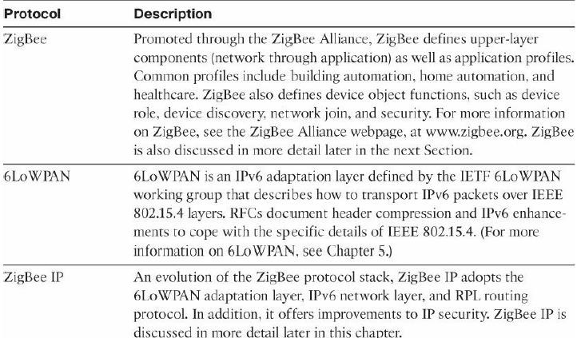
Module – 2 IoT Access Technologies
Protocol Stacks Utilizing IEEE 802.15.4

Slide 86
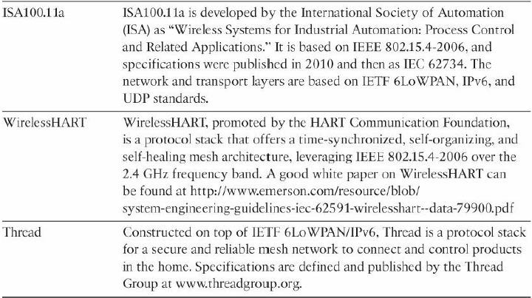
Module – 2 IoT Access Technologies
Protocol Stacks Utilizing IEEE 802.15.4

Slide 87
Module – 2 IoT Access Technologies
IoT Access Technologies: IEEE 802.15.4
ZigBee:
Based on the idea of ZigBee-style networks in the late 1990s, the first ZigBee specification was ratified in 2004, shortly after the release of the IEEE 802.15.4 specification the previous year.
industry support has grown to more than 400 companies that are members of the ZigBee
Alliance.
Similar to the Wi-Fi Alliance, the Zigbee Alliance is an industry group formed to certify interoperability between vendors and it is committed to driving and evolving ZigBee as an IoT solution for interconnecting smart objects.

Slide 88
Module – 2 IoT Access Technologies
IoT Access Technologies: IEEE 802.15.4
ZigBee:
ZigBee solutions are aimed at smart objects and sensors that have low bandwidth and low
power needs.
products that are ZigBee compliant and certified by the ZigBee Alliance should interoperate even though different vendors may manufacture them.
In the 2006 revision, sets of commands and message types were introduced, and increased in number in the 2007 (called Zigbee pro) iteration, to achieve different functions for a device, such as metering, temperature, or lighting control.
These sets of commands and message types are called clusters.

Slide 89
Module – 2 IoT Access Technologies
IoT Access Technologies: IEEE 802.15.4
ZigBee:
For home automation, ZigBee can control lighting, thermostats, and security functions.
ZigBee Smart Energy brings together a variety of interoperable products, such as smart meters, that can monitor and control the use and delivery of utilities, such as electricity and water.
These ZigBee products are controlled by the utility provider and can help coordinate usage between homes and businesses and the utility provider itself to provide more efficient operations.

Slide 90
Module – 2 IoT Access Technologies
IoT Access Technologies: IEEE 802.15.4
ZigBee:
ZigBee utilizes the IEEE 802.15.4 standard at the lower PHY and MAC layers.
ZigBee specifies the network and security layer and application support layer that sit on top
of the lower layers.
The ZigBee network and security layer provides mechanisms for network startup,
configuration, routing, and securing communications.
This includes calculating routing paths in what is often a changing topology, discovering
neighbors, and managing the routing tables as devices join for the first time.

Slide 91
Module – 2 IoT Access Technologies
IoT Access Technologies: IEEE 802.15.4
ZigBee:
The network layer is also responsible for forming the appropriate topology, which is often a
mesh but could be a star or tree as well.
From a security perspective, ZigBee utilizes 802.15.4 for security at the MAC layer, using the Advanced Encryption Standard (AES) with a 128-bit key and also provides security at the network and application layers.
The application support layer interfaces the lower portion of the stack dealing with the networking of ZigBee devices with the higher-layer applications.

Slide 92
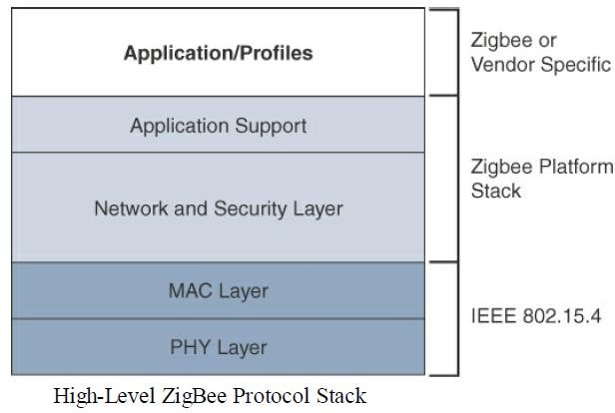
Module – 2 IoT Access Technologies
IoT Access Technologies: IEEE 802.15.4
ZigBee:

Slide 93
Module – 2 IoT Access Technologies
IoT Access Technologies: IEEE 802.15.4
ZigBee IP:
With the introduction of ZigBee IP, the support of IEEE 802.15.4 continues, but the IP and TCP/UDP protocols and various other open standards are now supported at the network and transport layers.
The ZigBee-specific layers are now found only at the top of the protocol stack for the
applications.
ZigBee IP was created to embrace the open standards coming from the IETF’s work on LLNs, such as IPv6, 6LoWPAN, and RPL.

Slide 94
Module – 2 IoT Access Technologies
IoT Access Technologies: IEEE 802.15.4
ZigBee IP:
They provide for low-bandwidth, low-power, and cost-effective communications when
connecting smart objects.
ZigBee IP is a critical part of the Smart Energy (SE) Profile 2.0 specification from the ZigBee Alliance. SE 2.0 is aimed at smart metering and residential energy management systems.
In fact, ZigBee IP was designed specifically for SE 2.0 but it is not limited to this use case.

Slide 95
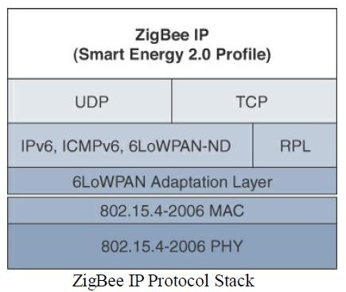
Module – 2 IoT Access Technologies
IoT Access Technologies: IEEE 802.15.4
ZigBee IP:

Slide 96
Module – 2 IoT Access Technologies
IoT Access Technologies: IEEE 802.15.4
ZigBee IP:
ZigBee IP supports 6LoWPAN as an adaptation layer
The 6LoWPAN mesh addressing header is not required as ZigBee IP utilizes the mesh-over or
route-over method for forwarding packets.
ZigBee IP requires the support of 6LoWPAN’s fragmentation and header compression
schemes.
At the network layer, all ZigBee IP nodes support IPv6, ICMPv6, and 6LoWPAN Neighbor Discovery (ND), and utilize RPL for the routing of packets across the mesh network.

Slide 97
Module – 2 IoT Access Technologies
IoT Access Technologies: IEEE 802.15.4
Physical Layer:
The 802.15.4 standard supports an extensive number of PHY options that range from 2.4
GHz to sub-GHz frequencies in ISM bands.
The original IEEE 802.15.4-2003 standard specified only three PHY options based on direct sequence spread spectrum (DSSS) modulation.
DSSS is a modulation technique in which a signal is intentionally spread in the frequency
domain, resulting in greater bandwidth.

Slide 98
Module – 2 IoT Access Technologies
IoT Access Technologies: IEEE 802.15.4
Physical Layer:
The original physical layer transmission options were as follows:
2.4 GHz, 16 channels, with a data rate of 250 kbps
915 MHz, 10 channels, with a data rate of 40 kbps
868 MHz, 1 channel, with a data rate of 20 kbps
only the 2.4 GHz band operates worldwide.

Slide 99
Module – 2 IoT Access Technologies
IoT Access Technologies: IEEE 802.15.4
Physical Layer:
IEEE 802.15.4- 2006, 802.15.4-2011, and IEEE 802.15.4-2015 introduced additional PHY
communication options, including the following:
OQPSK PHY:
This is DSSS PHY, employing offset quadrature phaseshift keying (OQPSK) modulation.
OQPSK is a modulation technique that uses four unique bit values that are signaled by phase changes.
An offset function that is present during phase shifts allows data to be transmitted more reliably.

Slide 100
Module – 2 IoT Access Technologies
IoT Access Technologies: IEEE 802.15.4
Physical Layer:
BPSK PHY:
This is DSSS PHY, employing binary phase-shift keying (BPSK) modulation.
BPSK specifies two unique phase shifts as its data encoding scheme.
ASK PHY:
This is parallel sequence spread spectrum (PSSS) PHY, employing amplitude shift keying (ASK)
and BPSK modulation.
PSSS is an advanced encoding scheme that offers increased range, throughput, data rates, and
signal integrity compared to DSSS. ASK uses amplitude shifts instead of phase shifts to signal
Dr. Syed Mustafa, HKBKCE 109
different bit values.

Slide 101
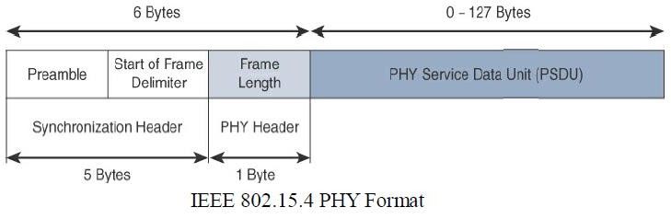
Module – 2 IoT Access Technologies
IoT Access Technologies: IEEE 802.15.4
Physical Layer:

Slide 102
Module – 2 IoT Access Technologies
IoT Access Technologies: IEEE 802.15.4
Physical Layer:
The synchronization header for this frame is composed of the Preamble and the Start of Frame Delimiter fields.
The Preamble field is a 32-bit 4-byte (for parallel construction) pattern that identifies the start of the frame and is used to synchronize the data transmission.
The Start of Frame Delimiter field informs the receiver that frame contents start immediately
after this byte.

Slide 103
Module – 2 IoT Access Technologies
IoT Access Technologies: IEEE 802.15.4
Physical Layer:
The PHY Header portion of the PHY frame shown in Figure is simply a frame length value.
It lets the receiver know how much total data to expect in the PHY service data unit (PSDU) portion of the 802.4.15 PHY.
The PSDU is the data field or payload.

Slide 104
Module – 2 IoT Access Technologies
IoT Access Technologies: IEEE 802.15.4
MAC Layer:
The IEEE 802.15.4 MAC layer manages access to the PHY channel by defining how devices in the same area will share the frequencies allocated.
The 802.15.4 MAC layer performs the following tasks:
Network beaconing for devices acting as coordinators (New devices use beacons to join an 802.15.4 network)
PAN association and disassociation by a device
Device security
Reliable link communications between two peer MAC entities

Slide 105
Module – 2 IoT Access Technologies
IoT Access Technologies: IEEE 802.15.4
MAC Layer:
The MAC layer achieves these tasks by using our types of MAC frames are specified in 802.15.4:
Data frame: Handles all transfers of data
Beacon frame: Used in the transmission of beacons from a PAN coordinator
Acknowledgement frame: Confirms the successful reception of a frame
MAC command frame: Responsible for control communication between
devices

Slide 106
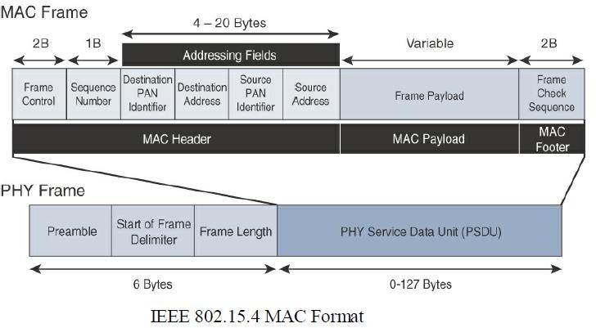
Module – 2 IoT Access Technologies
IoT Access Technologies: IEEE 802.15.4
MAC Layer:
Notice that the MAC frame is carried as the PHY payload.
The 802.15.4 MAC frame can be broken down into the MAC Header, MAC
Payload, and MAC Footer fields.
Dr. Syed Mustafa, HKBKCE
115

Slide 107
Module – 2 IoT Access Technologies
IoT Access Technologies: IEEE 802.15.4
MAC Layer:
The MAC Header field is composed of the Frame Control, Sequence Number and the Addressing fields.
The Frame Control field defines attributes such as frame type, addressing modes, and other
control flags.
The Sequence Number field indicates the sequence identifier for the frame.
The Addressing field specifies the Source and Destination PAN Identifier fields as well as the
Source and Destination Address fields.

Slide 108
Module – 2 IoT Access Technologies
IoT Access Technologies: IEEE 802.15.4
MAC Layer:
The MAC Payload field varies by individual frame type.
For example, beacon frames have specific fields and payloads related to beacons, while MAC
command frames have different fields present.
The MAC Footer field is nothing more than a frame check sequence (FCS).
An FCS is a calculation based on the data in the frame that is used by the receiving side to
confirm the integrity of the data in the frame.

Slide 109
Module – 2 IoT Access Technologies
IoT Access Technologies: IEEE 802.15.4
Topology:
IEEE 802.15.4–based networks can be built as star, peer-to-peer, or mesh topologies.
Mesh networks tie together many nodes.
This allows nodes that would be out of range if trying to communicate directly to leverage
intermediary nodes to transfer communications.
Every 802.15.4 PAN should be set up with a unique ID.
All the nodes in the same 802.15.4 network should use the same PAN ID.

Slide 110
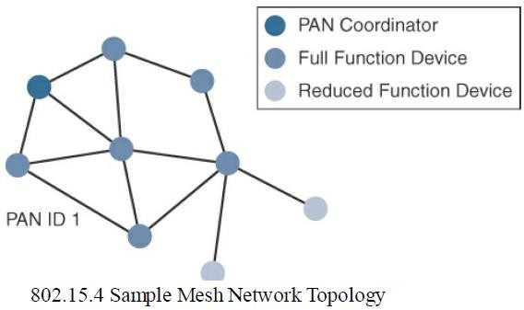
Module – 2 IoT Access Technologies
IoT Access Technologies: IEEE 802.15.4
Topology:

Slide 111
Module – 2 IoT Access Technologies
IoT Access Technologies: IEEE 802.15.4
Topology:
Full-function devices (FFDs) and reduced-function devices (RFDs) are defined in IEEE 802.15.4.
A minimum of one FFD acting as a PAN coordinator is required to deliver services that allow
other devices to associate and form a cell or PAN.
Notice in Figure that a single PAN coordinator is identified for PAN ID 1.
FFD devices can communicate with any other devices, whereas RFD devices can
communicate only with FFD devices.

Slide 112
Module – 2 IoT Access Technologies
IoT Access Technologies: IEEE 802.15.4
Security:
The IEEE 802.15.4 specification uses Advanced Encryption Standard (AES) with a 128-bit key length as the base encryption algorithm for securing its data.
Established by the US National Institute of Standards and Technology in 2001, AES is a block
cipher, which means it operates on fixed-size blocks of data.
The use of AES by the US government and its widespread adoption in the private sector has
helped it become one of the most popular algorithms used in symmetric key cryptography.

Slide 113
Module – 2 IoT Access Technologies
IoT Access Technologies: IEEE 802.15.4
Security:
In addition to encrypting the data, AES in 802.15.4 also validates the data that is sent.
This is accomplished by a message integrity code (MIC), which is calculated for the entire
frame using the same AES key that is used for encryption.
Enabling these security features for 802.15.4 changes the frame format slightly and consumes some of the payload.
Using the Security Enabled field in the Frame Control portion of the 802.15.4 header is the first step to enabling AES encryption.

Slide 114
Module – 2 IoT Access Technologies
IoT Access Technologies: IEEE 802.15.4
Security:
This Security Enabled field is a single bit that is set to 1 for security.
Once this bit is set, a field called the Auxiliary Security Header is created after the Source
Address field, by stealing some bytes from the Payload field.
Next Figure shows the IEEE 802.15.4 frame format at a high level, with the Security Enabled bit set and the Auxiliary Security Header field present.

Slide 115
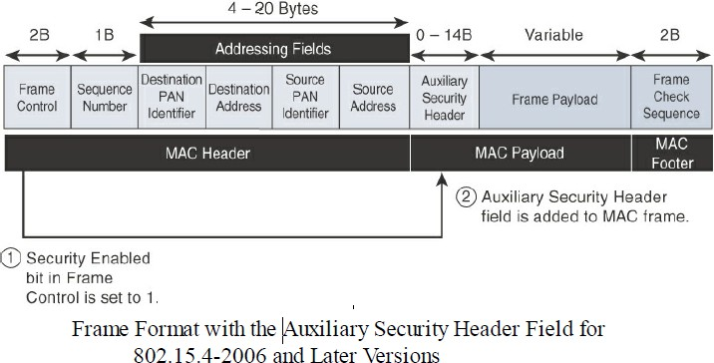
Module – 2 IoT Access Technologies
IoT Access Technologies: IEEE 802.15.4
Security:

Slide 116
Module – 2 IoT Access Technologies
IoT Access Technologies: IEEE 802.15.4
Competitive Technologies:
The IEEE 802.15.4 PHY and MAC layers are the foundations for several networking profiles that compete against each other in various IoT access environments.
These various vendors and organizations build upper-layer protocol stacks on top of an
802.15.4 core.
A competitive radio technology that is different in its PHY and MAC layers is DASH7.
DASH7 was originally based on the ISO18000-7 standard and positioned for industrial
communications, whereas IEEE 802.15.4 is more generic.

Slide 117
Module – 2 IoT Access Technologies
IoT Access Technologies: IEEE 802.15.4
Competitive Technologies:
Commonly employed in active radio frequency identification (RFID) implementations, DASH7 was used by US military forces for many years, mainly for logistics purposes.
Active RFID utilizes radio waves generated by a battery-powered tag on an object to enable
continuous tracking.
The current DASH7 technology offers low power consumption, a compact protocol stack,
range up to 1 mile, and AES encryption.
Frequencies of 433 MHz, 868 MHz, and 915 MHz have been defined, enabling data rates up to 166.667 kbps and a maximum payload of 256 bytes.

Slide 118
Module – 2 IoT Access Technologies
IoT Access Technologies: IEEE 802.15.4
IEEE 802.15.4 Conclusions:
The IEEE 802.15.4 wireless PHY and MAC layers are mature specifications that are the
foundation for various industry standards and products
The PHY layer offers a maximum speed of up to 250 kbps, but this varies based on
modulation and frequency.
The MAC layer for 802.15.4 is robust and handles how data is transmitted and received over the PHY layer.
Specifically, the MAC layer handles the association and disassociation of devices to/from a
PAN,
reliable
communications
between
devices,
security,
and
the
formation
of
topologies.

Slide 119
Module – 2 IoT Access Technologies
IoT Access Technologies: IEEE 802.15.4
IEEE 802.15.4 Conclusions:
The topologies used in 802.15.4 include star, peer-to-peer, and cluster trees that allow for the formation of mesh networks.
From a security perspective, 802.15.4 utilizes AES encryption to allow secure communications and also provide data integrity. The main competitor to IEEE 802.15.4 is DASH7, another wireless technology
IEEE 802.15.4 has an edge in the marketplace through all the different vendors and
organizations that utilize its PHY and MAC layers.
For IoT sensor deployments requiring low power, low data rate, and low complexity, the IEEE
802.15.4 standard deserves strong cons^{D}i^{r.}d^{Sy}e^{e}r^{d}a^{M}t^{u}i^{s}o^{taf}n^{a,}.^{HKBKCE}
128

Slide 120
Module – 2 IoT Access Technologies
IoT Access Technologies: IEEE 802.15.4g and 802.15.4e
The IEEE 802.15.4e amendment of 802.15.4-2011 expands the MAC layer feature set to remedy the disadvantages associated with 802.15.4, including MAC reliability, unbounded latency, and multipath fading.
In addition to making general enhancements to the MAC layer, IEEE 802.15.4e also made improvements to better cope with certain application domains, such as factory and process automation and smart grid.
Smart grid is associated with the modernization of the power grid and utilities infrastructure by connecting intelligent devices and communications.
IEEE 802.15.4e-2012 enhanced the IEEE 802.15.4 MAC layer capabilities in the areas of frame
format, security, determinism mechanism,^{Dr}a^{. S}n^{ye}d^{d M}f^{u}r^{s}e^{ta}q^{fa,}u^{H}e^{KB}n^{KC}c^{E}y hopping.
129

Slide 121
Module – 2 IoT Access Technologies
IoT Access Technologies: IEEE 802.15.4g and 802.15.4e
802.15.4g seeks to optimize large outdoor wireless mesh networks for field area networks (FANs).
New PHY definitions are introduced, as well as some MAC modifications needed to support their implementation.
This technology applies to IoT use cases such as :
Distribution automation and industrial supervisory control and data acquisition (SCADA)
environments for remote monitoring and control .
Public lighting

Slide 122
Module – 2 IoT Access Technologies
IoT Access Technologies: IEEE 802.15.4g and 802.15.4e
Environmental wireless sensors in smart cities
Electrical vehicle charging stations
Smart parking meters
Microgrids
Renewable energy

Slide 123
Module – 2 IoT Access Technologies
IoT Access Technologies: IEEE 802.15.4g and 802.15.4e
Standardization and Alliances
Because 802.15.4g-2012 and 802.15.4e-2012 are simply amendments to IEEE 802.15.4-2011, the same IEEE 802.15 Task Group 4 standards body authors, maintains, and integrates them into the next release of the core specification.
The additional capabilities and options provided by 802.15.4g-2012 and 802.15.4e-2012 led to additional difficulty in achieving the interoperability between devices and mixed vendors that users requested.

Slide 124
Module – 2 IoT Access Technologies
IoT Access Technologies: IEEE 802.15.4g and 802.15.4e
Standardization and Alliances
To guarantee interoperability, the Wi-SUN Alliance was formed. (SUN stands for smart utility network.)
This organization is not a standards body but is instead an industry alliance that defines communication profiles for smart utility and related networks.
These profiles are based on open standards, such as 802.15.4g-2012, 802.15.4e-2012, IPv6,
6LoWPAN, and UDP for the FAN profile.

Slide 125
Module – 2 IoT Access Technologies
IoT Access Technologies: IEEE 802.15.4g and 802.15.4e
Physical Layer:
In IEEE 802.15.4g-2012, the original IEEE 802.15.4 maximum PSDU or payload size of 127 bytes was increased for the SUN PHY to 2047 bytes.
This provides a better match for the greater packet sizes found in many upper-layer protocols.
For example, the default IPv6 MTU setting is 1280 bytes.
Fragmentation is no longer necessary at Layer 2 when IPv6 packets are transmitted over IEEE
802.15.4g MAC frames.
the error protection was improved in IEEE 802.15.4g by evolving the CRC from 16 to 32 bits.

Slide 126
Module – 2 IoT Access Technologies
IoT Access Technologies: IEEE 802.15.4g and 802.15.4e
Physical Layer:
The SUN PHY, as described in IEEE 802.15.4g-2012, supports multiple data rates in bands ranging from 169 MHz to 2.4 GHz.
These bands are covered in the unlicensed ISM frequency spectrum specified by various countries and regions.
Within these bands, data must be modulated onto the frequency using at least one of the
following PHY mechanisms to be IEEE 802.15.4g compliant:

Slide 127
Module – 2 IoT Access Technologies
IoT Access Technologies: IEEE 802.15.4g and 802.15.4e
Physical Layer:
Multi-Rate and Multi-Regional Frequency Shift Keying (MR-FSK):
Offers good transmit power efficiency due to the constant envelope of the transmit signal
Multi-Rate and Multi-Regional Orthogonal Frequency Division Multiplexing (MR-OFDM):
Provides higher data rates but may be too complex for low-cost and low-power devices
Multi-Rate and Multi-Regional Offset Quadrature Phase-Shift Keying (MR-O-QPSK):
Shares the same characteristics of the IEEE 802.15.4-2006 O-QPSK PHY, making multi-mode systems more cost effective and easier to design

Slide 128
Module – 2 IoT Access Technologies
IoT Access Technologies: IEEE 802.15.4g and 802.15.4e
MAC Layer:
While the IEEE 802.15.4e-2012 amendment is not applicable to the PHY layer, it is pertinent to the MAC layer.
This amendment enhances the MAC layer through various functions, which may be selectively enabled based on various implementations of the standard.

Slide 129
Module – 2 IoT Access Technologies
IoT Access Technologies: IEEE 802.15.4g and 802.15.4e
MAC Layer:
The following are some of the main enhancements to the MAC layer proposed by IEEE 802.15.4e-2012:
Time-Slotted Channel Hopping (TSCH):
TSCH is an IEEE 802.15.4e- 2012 MAC operation mode that works to guarantee media access and channel diversity.
Channel hopping, also known as frequency hopping, utilizes different channels for transmission at different times.
TSCH divides time into fixed time periods, or “time slots,” which offer guaranteed bandwidth and
predictable latency.

Slide 130
Module – 2 IoT Access Technologies
IoT Access Technologies: IEEE 802.15.4g and 802.15.4e
MAC Layer:
Time-Slotted Channel Hopping (TSCH):
In a time slot, one packet and its acknowledgement can be transmitted, increasing network capacity because multiple nodes can communicate in the same time slot, using different channels.
A number of time slots are defined as a “slot frame,” which is regularly repeated to provide “guaranteed
access.”
The transmitter and receiver agree on the channels and the timing for switching between channels through the combination of a global time slot counter and a global channel hopping sequence list, as computed on each node to determine the channel of each time slot.
TSCH adds robustness in noisy environments and smoother coexistence with other wireless
technologies, especially for industrial use ca^{D}s^{r.} e^{Sy}s^{e}.^{d Mustafa, HKBKCE}
139

Slide 131
Module – 2 IoT Access Technologies
IoT Access Technologies: IEEE 802.15.4g and 802.15.4e
MAC Layer:
Information elements:
Information elements (IEs) allow for the exchange of information at the MAC layer in an extensible
manner, either as header IEs (standardized) and/or payload IEs (private).
Specified in a tag, length, value (TLV) format, the IE field allows frames to carry additional metadata to support MAC layer services.
These services may include IEEE 802.15.9 key management, Wi-SUN 1.0 IEs to broadcast and unicast schedule timing information, and frequency hopping synchronization information for the 6TiSCH architecture.

Slide 132
Module – 2 IoT Access Technologies
IoT Access Technologies: IEEE 802.15.4g and 802.15.4e
MAC Layer:
Enhanced beacons (EBs):
EBs extend the flexibility of IEEE 802.15.4 beacons to allow the construction of application-specific
beacon content.
This is accomplished by including relevant IEs in EB frames.
Some IEs that may be found in EBs include network metrics, frequency hopping broadcast schedule, and PAN information version.

Slide 133
Module – 2 IoT Access Technologies
IoT Access Technologies: IEEE 802.15.4g and 802.15.4e
MAC Layer:
Enhanced beacon requests (EBRs):
Like enhanced beacons, an enhanced beacon request (EBRs) also leverages IEs.
The IEs in EBRs allow the sender to selectively specify the request of information.
For example, a device can query for a PAN that is allowing new devices to join or a PAN that supports a certain set of MAC/PHY capabilities.

Slide 134
Module – 2 IoT Access Technologies
IoT Access Technologies: IEEE 802.15.4g and 802.15.4e
MAC Layer:
Enhanced Acknowledgement:
The Enhanced Acknowledgement frame allows for the integration of a frame counter for the frame being
acknowledged.
This feature helps protect against certain attacks that occur when Acknowledgement frames are spoofed.

Slide 135
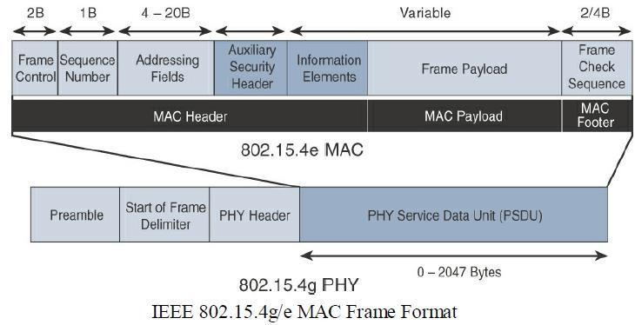
Module – 2 IoT Access Technologies
IoT Access Technologies: IEEE 802.15.4g and 802.15.4e
MAC Layer:

Slide 136
Module – 2 IoT Access Technologies
IoT Access Technologies: IEEE 802.15.4g and 802.15.4e
MAC Layer:
The 802.15.4e MAC is similar to the 802.15.4 MAC
The main changes shown in the IEEE 802.15.4e header are the presence of the Auxiliary Security Header
and Information Elements field.
The Auxiliary Security header provides for the encryption of the data frame.
This field is optionally supported in both 802.15.4e-2012 and 802.15.4, starting with the 802.15.4-2006 specification.
the IE field contains one or more information elements that allow for additional information to be exchanged at the MAC layer.

Slide 137
Module – 2 IoT Access Technologies
IoT Access Technologies: IEEE 802.15.4g and 802.15.4e
Topology:
Deployments of IEEE 802.15.4g-2012 are mostly based on a mesh topology.
because a mesh topology is typically the best choice for use cases in the industrial and smart cities areas
where 802.15.4g-2012 is applied.
A mesh topology allows deployments to be done in urban or rural areas, expanding the distance between nodes that can relay the traffic of other nodes.
Support for battery-powered nodes with a long lifecycle requires optimized Layer 2 forwarding or Layer 3 routing protocol implementations.
This provides an extra level of complexity but is necessary in order to cope with sleeping battery-
powered nodes.
Dr. Syed Mustafa, HKBKCE 146

Slide 138
Module – 2 IoT Access Technologies
IoT Access Technologies: IEEE 802.15.4g and 802.15.4e
Security:
Both IEEE 802.15.4g and 802.15.4e inherit their security attributes from the IEEE 802.15.4-2006 specification.
encryption is provided by AES, with a 128-bit key.
In addition to the Auxiliary Security Header field initially defined in 802.15.4-2006, a secure acknowledgement and a secure Enhanced Beacon field complete the MAC layer security.

Slide 139
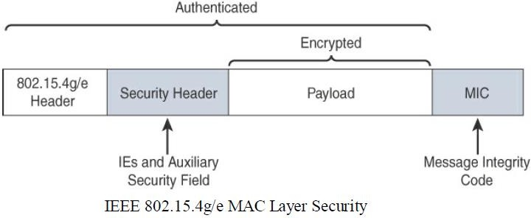
Module – 2 IoT Access Technologies
IoT Access Technologies: IEEE 802.15.4g and 802.15.4e
Security:

Slide 140
Module – 2 IoT Access Technologies
IoT Access Technologies: IEEE 802.15.4g and 802.15.4e
Security:
The full frame gets authenticated through the MIC at the end of frame. The MIC is a unique value that is calculated based on the frame contents.
The Security Header field is composed of the Auxiliary Security field and one or more Information Elements fields.
Integration of the Information Elements fields allows for the adoption of additional security
capabilities, such as the IEEE 802.15.9 Key Management Protocol (KMP) specification.
KMP provides a means for establishing keys for robust datagram security.

Slide 141
Module – 2 IoT Access Technologies
IoT Access Technologies: IEEE 802.15.4g and 802.15.4e
Competitive Technologies:
Competitive technologies to IEEE 802.15.4g and 802.15.4e parallel the technologies that also compete with IEEE 802.15.4, such as DASH7.
IEEE 802.15.4 is well established and already deployed in many scenarios, mostly indoors.

Slide 142
Module – 2 IoT Access Technologies
IoT Access Technologies: IEEE 802.15.4g and 802.15.4e
IEEE 802.15.4g and 802.15.4e Conclusions:
IEEE 802.15.4g and 802.15.4e are simply amendments to the IEEE 802.15.4 standard.
They are mature specifications that are integrated into IEEE 802.15.4-2015.
They have been successfully deployed in real-world scenarios, and already support millions of endpoints.
IEEE 802.15.4g focuses mainly on improvements to the PHY layer, while IEEE 802.15.4e targets
the MAC layer.

Slide 143
Module – 2 IoT Access Technologies
IoT Access Technologies: IEEE 802.15.4g and 802.15.4e
IEEE 802.15.4g and 802.15.4e Conclusions:
These improvements overcome many of the disadvantages of IEEE 802.15.4, such as latency and vulnerability to multipath fading.
The Wi-SUN Alliance is an important industry alliance that provides interoperability and certification for industry implementations.
Utilizing 802.15.4g as a foundation, the alliance releases profiles, such as the FAN profile, to help promote the adoption of the technology while guaranteeing interoperability between vendors.

